Slide 1
Trial 4
Physical layout
XVR Simulation
21 November 2018, Netherlands

Slide 2
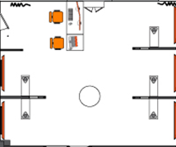

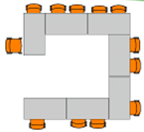
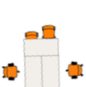

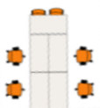
Physical layout – Baseline (Flood & Threat)
Scenario coordinator
Response cell – GBT & higher
Technicians
& support
Response cell – Water & critical infra
Response cell – Police & Defence
LCMS
Response cell – Medical
Response cell – Fire & CoPI’s
ROT
LCMS
LCMS
LCMS
AC Medical
3Di
LCMS
LCMS
LCMS
Water board
AC Police
AC Fire
AC Municipality
Military AC
HTM
Power infra (Stedin)
Drinking water
(Dunea)
International Organisations

Slide 3
Physical layout –Threat Phase (innovation)
Scenario coordinator
Response cell – GBT & higher
Technicians
& support
Response cell – Water & critical infra
Response cell – Police & Defence
LCMS
Response cell – Medical
Response cell – Fire & CoPI’s
ROT
LCMS
LCMS
LCMS
AC Medical
Humlog
3Di
Keep Op.
LCMS
LCMS
COP
LCMS
SimCI
Water board
COP
COP
AC Police
SimCI
AC Fire
SimCI
AC Municipality
Military AC
COP
HTM
Power infra (Stedin)
Drinking water
(Dunea)
International Organisations

Slide 4
Physical layout –Flood Phase (innovation)
Scenario coordinator
Response cell – GBT & higher
Technicians
& support
Response cell – Water & critical infra
Response cell – Police & Defence
LCMS
Response cell – Medical
Response cell – Fire & CoPI’s
ROT
LCMS
LCMS
LCMS
ZKI
AC Medical
Humlog
3Di
LCMS
Keep Op.
ZKI
LCMS
COP
LCMS
SimCI
Water board
COP
COP
AC Police
SimCI
AC Fire
SimCI
AC Municipality
Military AC
COP
HTM
Power infra (Stedin)
Drinking water
(Dunea)
International Organisations

